Slide 1
군집 분석 - 2
최도진

Slide 2
What is clustering?
Ch. 16
Clustering: the process of grouping a set of objects into classes of similar objects
Documents within a cluster should be similar.
Documents from different clusters should be dissimilar.
The commonest form of unsupervised learning
Unsupervised learning = learning from raw data, as opposed to supervised data where a classification of examples is given
A common and important task that finds many applications in IR and other places

Slide 3
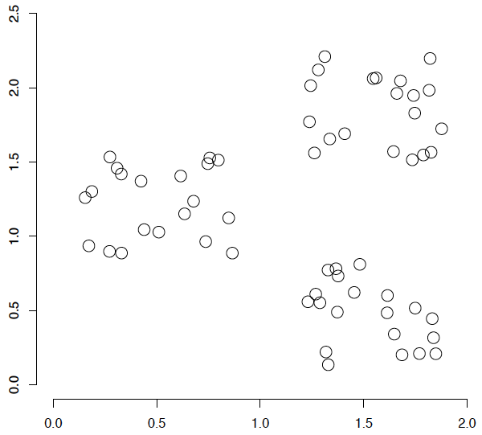
A data set with clear cluster structure
Ch. 16
How would you design an algorithm for finding the three clusters in this case?

Slide 4
Applications of clustering in IR
Sec. 16.1
Whole corpus analysis/navigation
Better user interface: search without typing
For improving recall in search applications
Better search results (like pseudo RF)
For better navigation of search results
Effective “user recall” will be higher
For speeding up vector space retrieval
Cluster-based retrieval gives faster search

Slide 5
Yahoo! Hierarchy isn’t clustering but is the kind of output you want from clustering
www.yahoo.com/Science
… (30)
agriculture
biology
physics
CS
space
...
...
...
...
...
dairy
crops
botany
cell
AI
courses
craft
magnetism
HCI
missions
forestry
agronomy
evolution
relativity
Notes:
Final data set:
Yahoo Science hierarchy, consisting of text of web pages pointed to by Yahoo, gathered summer of 1997.
264 classes, only sample shown here.

Slide 6
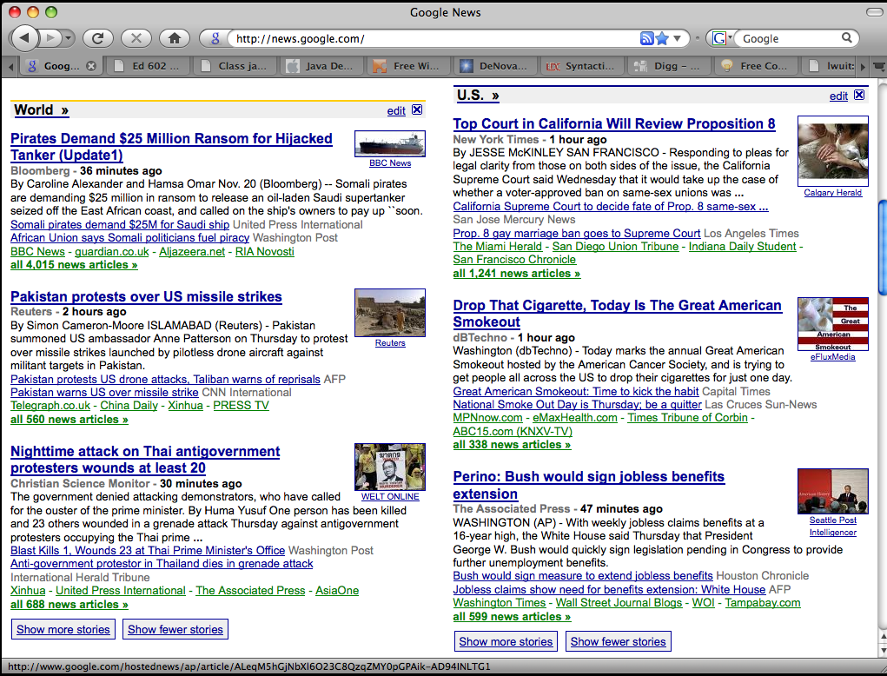
Google News: automatic clustering gives an effective news presentation metaphor

Slide 7
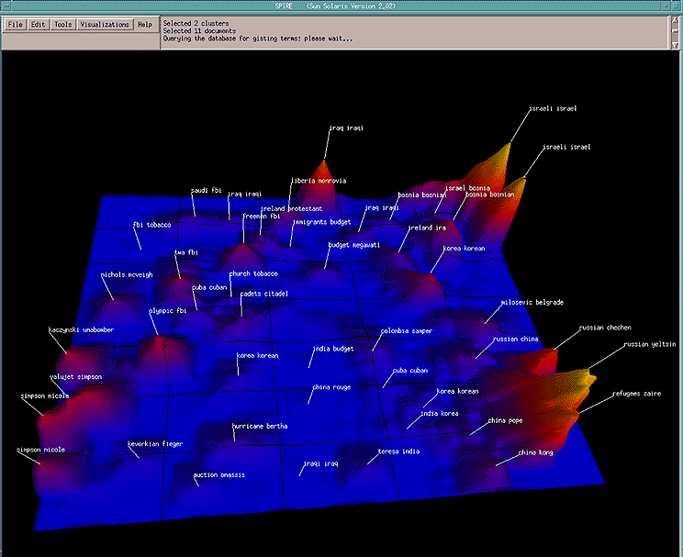
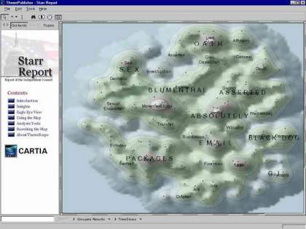
For visualizing a document collection and its themes
Wise et al, “Visualizing the non-visual” PNNL
ThemeScapes, Cartia
[Mountain height = cluster size]

Slide 8
For improving search recall
Sec. 16.1
Cluster hypothesis - Documents in the same cluster behave similarly with respect to relevance to information needs
Therefore, to improve search recall:
Cluster docs in corpus a priori
When a query matches a doc D, also return other docs in the cluster containing D
Hope if we do this: The query “car” will also return docs containing automobile
Because clustering grouped together docs containing car with those containing automobile.
Why might this happen?

Slide 9
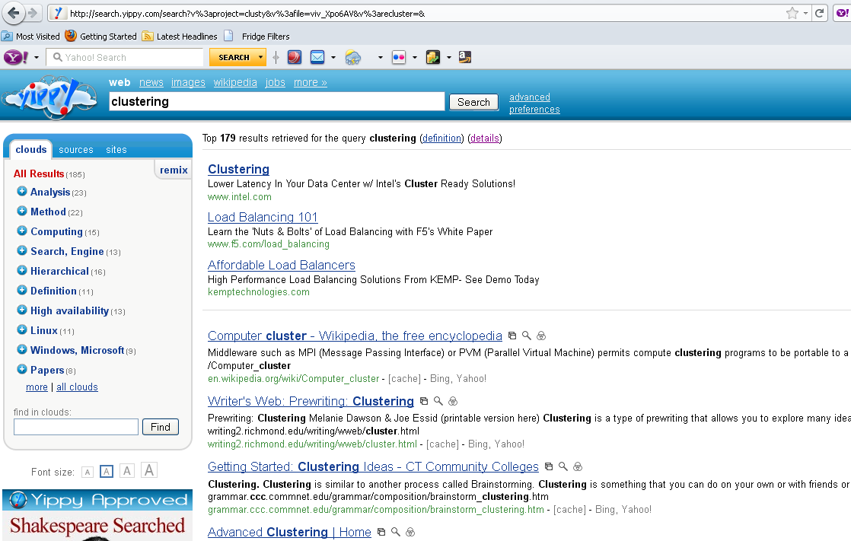
yippy.com – grouping search results

Slide 10
Issues for clustering
Sec. 16.2
Representation for clustering
Document representation
Vector space? Normalization?
Centroids aren’t length normalized
Need a notion of similarity/distance
How many clusters?
Fixed a priori?
Completely data driven?
Avoid “trivial” clusters - too large or small
If a cluster's too large, then for navigation purposes you've wasted an extra user click without whittling down the set of documents much.

Slide 11
Notion of similarity/distance
Ideal: semantic similarity.
Practical: term-statistical similarity
We will use cosine similarity.
Docs as vectors.
For many algorithms, easier to think in terms of a distance (rather than similarity) between docs.
We will mostly speak of Euclidean distance
But real implementations use cosine similarity

Slide 12
Hard vs. soft clustering
Hard clustering: Each document belongs to exactly one cluster
More common and easier to do
Soft clustering: A document can belong to more than one cluster.
Makes more sense for applications like creating browsable hierarchies
You may want to put a pair of sneakers in two clusters: (i) sports apparel and (ii) shoes
You can only do that with a soft clustering approach.

Slide 13
군집분석 알고리즘의 유형
거리함수(distance function) 기반
계층형
Hierarchical clustering
Complete-linkage
Single-linkage
Centroid-linkage
Average-linkage
평면형
Partitional clustering
k-means
밀도(density) 기반
DBScan

Slide 14
평면형 Clustering: k-means
i 단계
: centroid
(i+1) 단계

Slide 15

Seed Choice
Sec. 16.4
Results can vary based on random seed selection.
Some seeds can result in poor convergence rate, or convergence to sub-optimal clusterings.
Select good seeds using a heuristic (e.g., doc least similar to any existing mean)
Try out multiple starting points
Initialize with the results of another method.
Example showing
sensitivity to seeds
In the above, if you start
with B and E as centroids
you converge to {A,B,C}
and {D,E,F}
If you start with D and F
you converge to
{A,B,D,E} {C,F}

Slide 16
How Many Clusters?
Number of clusters K is given
Partition n docs into predetermined number of clusters
Finding the “right” number of clusters is part of the problem
Given docs, partition into an “appropriate” number of subsets.
E.g., for query results - ideal value of K not known up front - though UI may impose limits.
Can usually take an algorithm for one flavor and convert to the other.

Slide 17
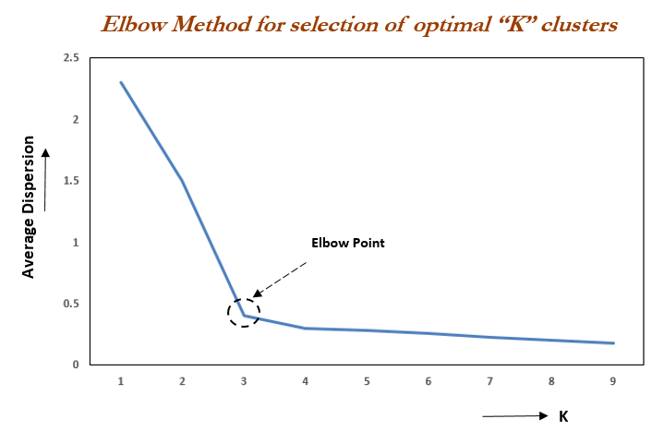

Slide 18
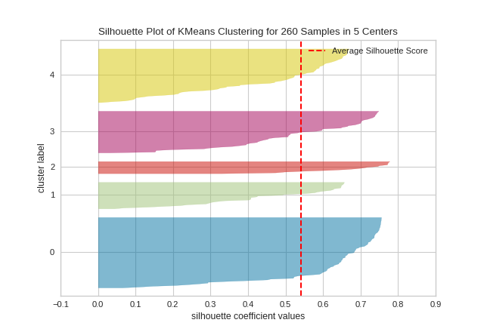

Slide 19
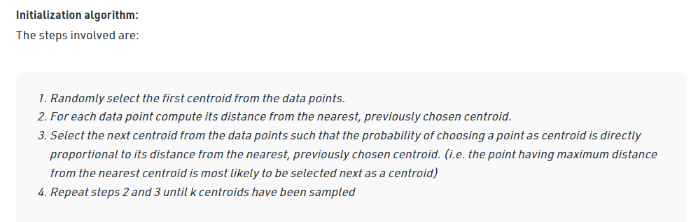
k-means++

Slide 20
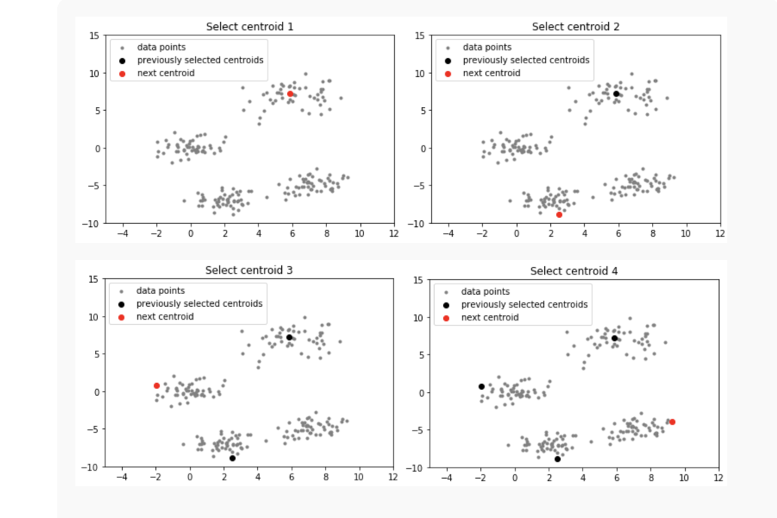

Slide 21
Hierarchical Clustering
Ch. 17
Build a tree-based hierarchical taxonomy (dendrogram) from a set of documents.
One approach: recursive application of a partitional clustering algorithm.
animal
vertebrate
invertebrate
fish reptile amphib. mammal worm insect crustacean

Slide 22
Hierarchical Clustering
0step
1step
2step
3step
4step
Bottom-up (agglomerative)
a
a b
b
a b c d e
c
c d e
e
d e
d
Top-down
(divisive)
4step
3step
2step
1step
0step

Slide 23
Dendrogram: Hierarchical Clustering
Clustering obtained by cutting the dendrogram at a desired level: each connected component forms a cluster.

Slide 24
Hierarchical Agglomerative Clustering (HAC)
Sec. 17.1
Starts with each doc in a separate cluster
then repeatedly joins the closest pair of clusters, until there is only one cluster.
The history of merging forms a binary tree or hierarchy.
Note: the resulting clusters are still “hard” and induce a partition

Slide 25
Closest pair of clusters
Sec. 17.2
Many variants to defining closest pair of clusters
Single-link
Similarity of the most cosine-similar (single-link)
Complete-link
Similarity of the “furthest” points, the least cosine-similar
Centroid
Clusters whose centroids (centers of gravity) are the most cosine-similar
Average-link
Average cosine between pairs of elements

Slide 26
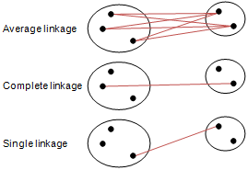
Hierarchical Agglomerative Clustering
4가지 유형
Simple linkage
Complete linkage
Average linkage
Centroid linkage

Slide 27
Single Link Agglomerative Clustering
Sec. 17.2
Use maximum similarity of pairs:
Can result in “straggly” (long and thin) clusters due to chaining effect.
After merging c_{i} and c_{j}, the similarity of the resulting cluster to another cluster, c_{k}, is:

Slide 28
Single Link Example
Sec. 17.2

Slide 29
Complete Link
Sec. 17.2
Use minimum similarity of pairs:
Makes “tighter,” spherical clusters that are typically preferable.
After merging c_{i} and c_{j}, the similarity of the resulting cluster to another cluster, c_{k}, is:
C_{i}
C_{j}
C_{k}

Slide 30
Complete Link Example
Sec. 17.2

Slide 31
What Is A Good Clustering?
Sec. 16.3
Internal criterion: A good clustering will produce high quality clusters in which:
the intra-class (that is, intra-cluster) similarity is high
the inter-class similarity is low
The measured quality of a clustering depends on both the document representation and the similarity measure used

Slide 32
External criteria for clustering quality
Sec. 16.3
Quality measured by its ability to discover some or all of the hidden patterns or latent classes in gold standard data
Assesses a clustering with respect to ground truth … requires labeled data
Assume documents with C gold standard classes, while our clustering algorithms produce K clusters, ω₁, ω₂, …, ω_{K} with n_{i} members.

Slide 33
External Evaluation of Cluster Quality
Sec. 16.3
Simple measure: purity, the ratio between the dominant class in the cluster π_{i} and the size of cluster ω_{i}
Biased because having n clusters maximizes purity
Others are entropy of classes in clusters (or mutual information between classes and clusters)

Slide 34
Purity example
Sec. 16.3
• •
• •
• •
• •
• •
• •
• •
• •
•
Cluster I
Cluster II
Cluster III
Cluster I: Purity = 1/6 (max(5, 1, 0)) = 5/6
Cluster II: Purity = 1/6 (max(1, 4, 1)) = 4/6
Cluster III: Purity = 1/5 (max(2, 0, 3)) = 3/5

Slide 35
Rand Index measures between pair decisions. Here RI = 0.68
Sec. 16.3
Number of points | Same Cluster in clustering | Different Clusters in clustering
Same class in ground truth | 20 | 24
Different classes in ground truth | 20 | 72

Slide 36
Rand index and Cluster F-measure
Sec. 16.3
Compare with standard Precision and Recall:
People also define and use a cluster F-measure, which is probably a better measure.

Slide 37
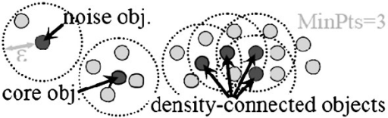
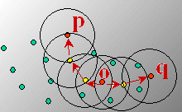
밀도기반 Clustering
DBSCAN(Density-based Spatial Clustering of Applications with Noise): Cluster를 “density-connected set”으로 정의
density: 정해진 반경(ε)내에 데이터의 개수

Slide 38
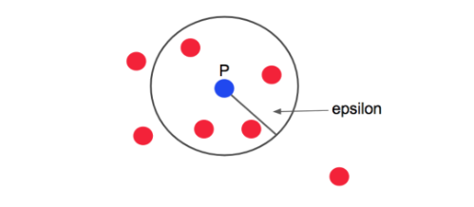
밀도기반 Clustering
p : 기준 점
epsilon : 반경
minPts : 기준 갯수 (ex : 4)
e내에 점 m 개를 가지고 있는 점 p = core point

Slide 39
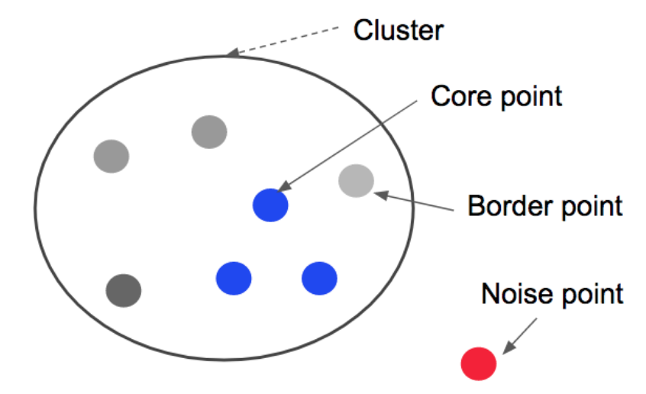
밀도기반 Clustering
e내에 점 m 개를 가지고 있지 않는 점 p
core point의 반경 안에 들어있다면 : boarder point
core point의 반경 안에 들어있지 않다면: noise point

Slide 40
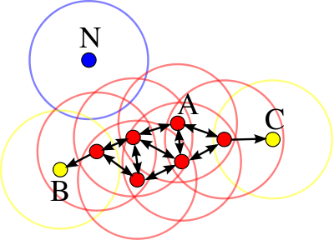

Slide 41
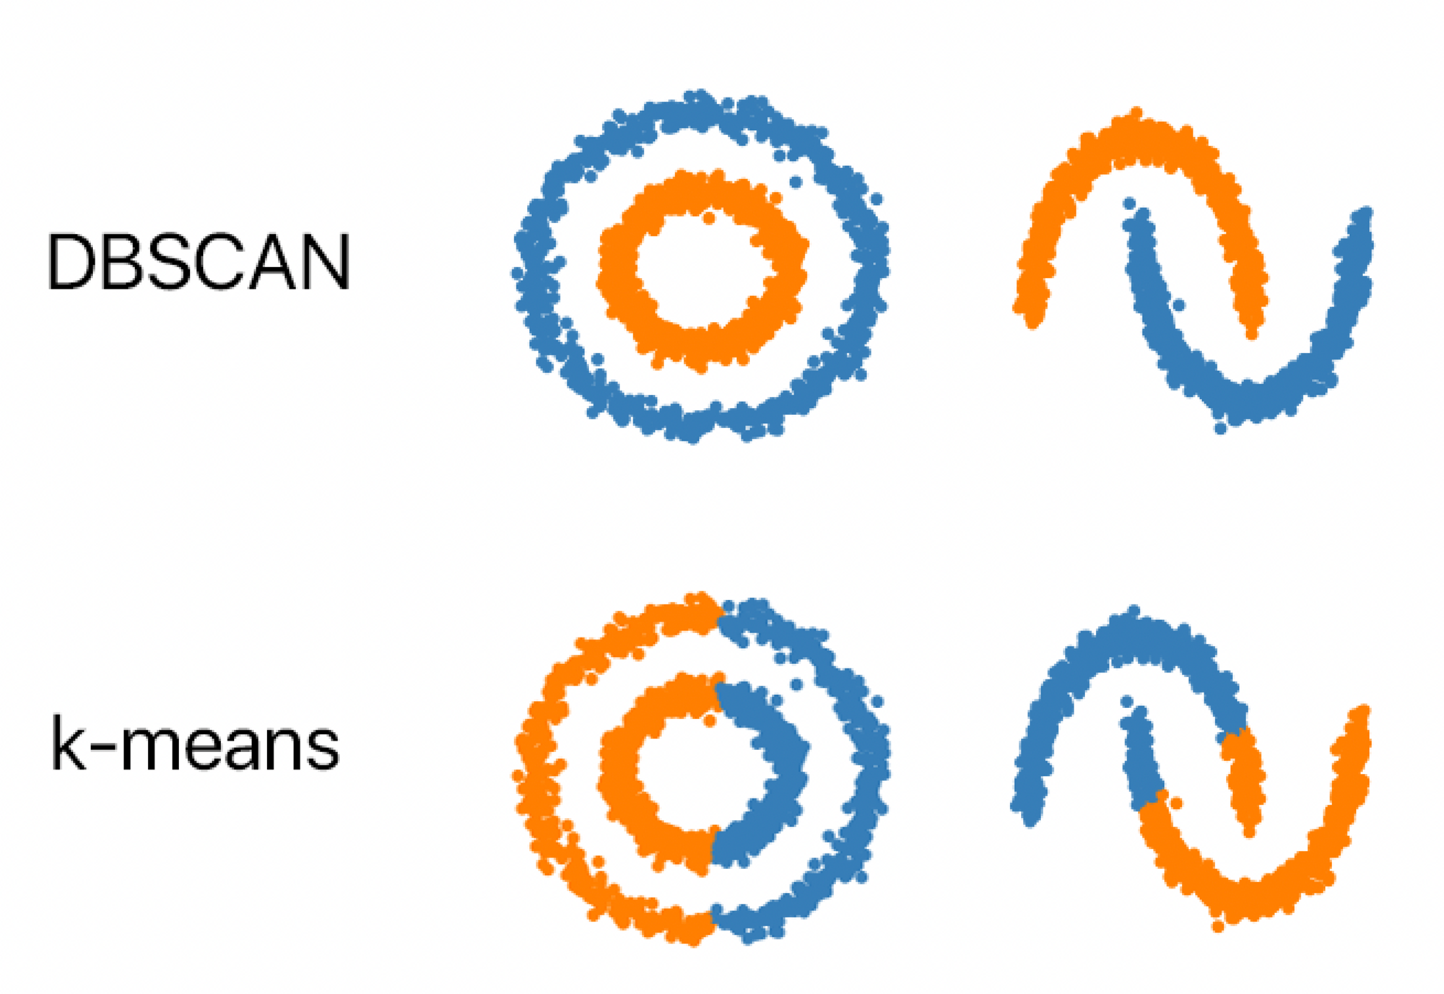

Slide 42
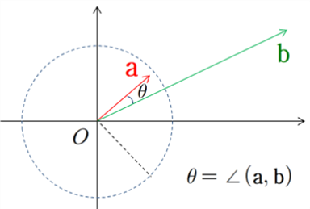
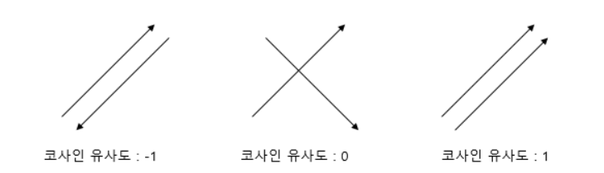
similarity

Slide 43
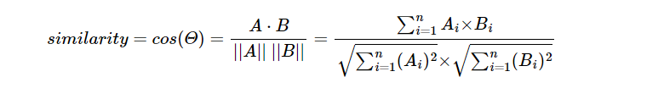
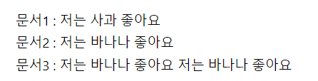
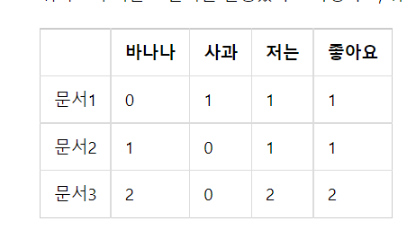
a
문서 간 유사도
문서 1 : 문서 2
문서 1 : 문서 3
문서 2 : 문서 3

Slide 44
